Slide 1
JavaScript Review
alert, variables, data types, prompt, buttons, functions

Slide 2
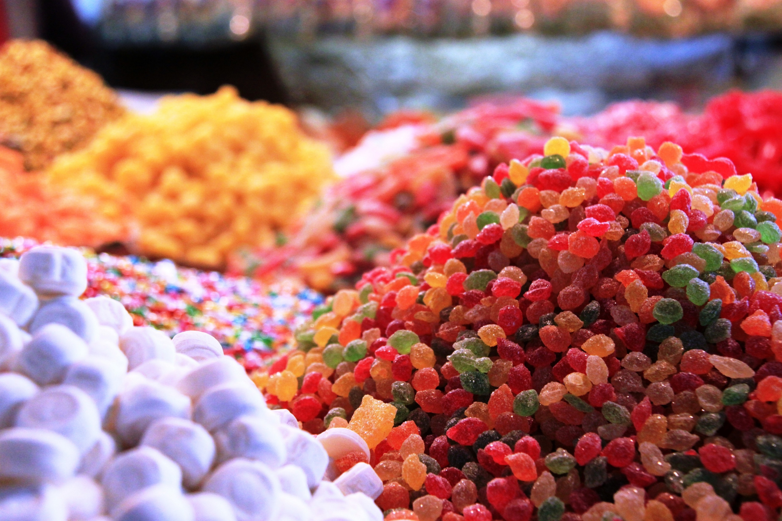
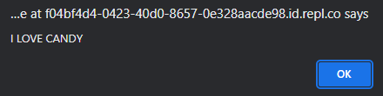
Showing Pop-ups With alert
alert("I LOVE CANDY")
alert
Parentheses: ( )
Quotes inside: " "
Message inside quotes

Slide 3
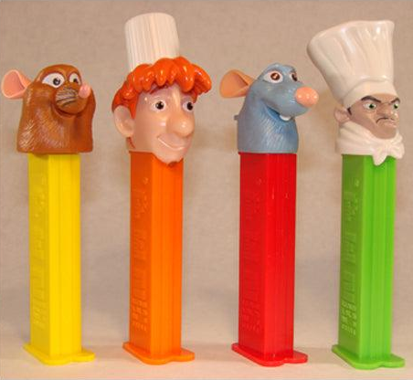
Storing Data with Variables
let animal = "rat"
let
Variable Name
Equals Sign: =
Variable Value

Slide 4
Variable Assignment
let num = 7;
num = num + 1;
num
8
num
7
In JavaScript, the equals sign is not used for equality! It is used to set the value of a variable!!!!!!!!!!!!!!!!!!!!!!!

Slide 5
Two Basic Data Types
Strings
Numbers
Strings store text values
They are surrounded by quotes: " "
Numbers store numbers
They have no quotes
You can do arithmetic
"i love reese's"
4028884

Slide 6
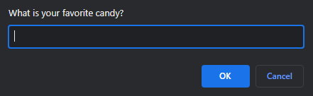
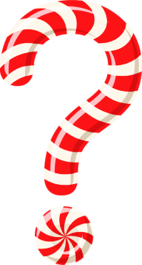
Asking Questions With prompt
let candy = prompt("What is your favorite candy?")
Variable: let, name, =
prompt
Parentheses: ( )
Quotes inside: " "
Question inside quotes
twix
candy
"twix"

Slide 7
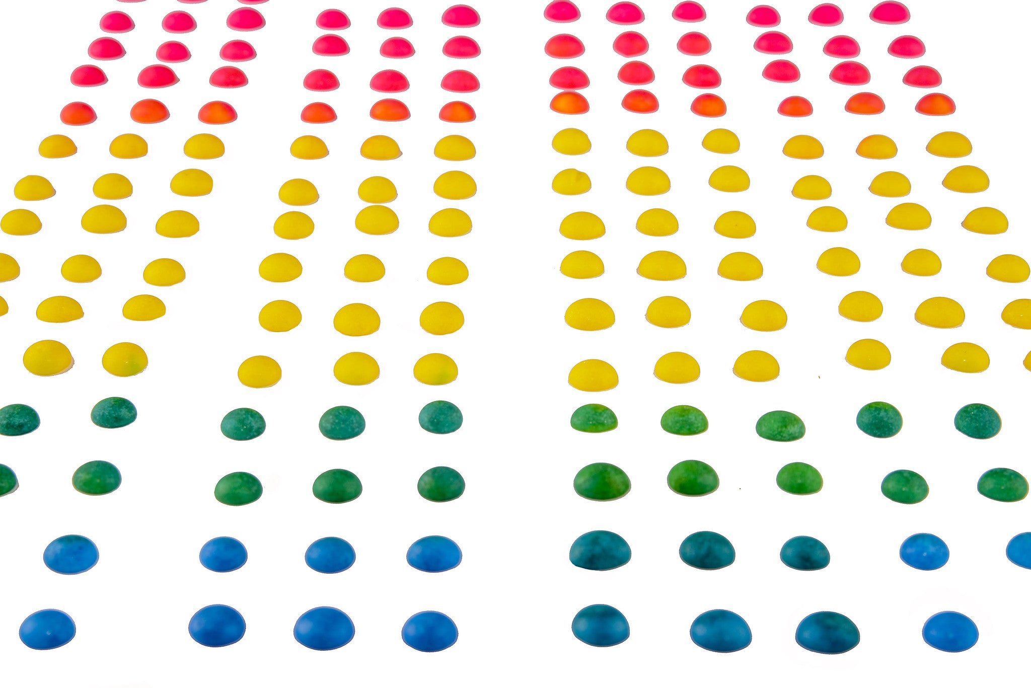
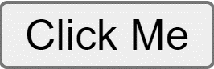
Creating buttons in HTML
<button onclick="doThing()">Click Me</button>
<button></button>
onclick attribute
Equals Sign, Quotes
Function in the quotes
Text to display
The doThing function will run when you click this button

Slide 8


Two Sides to Functions
Define
Call
Decide what happens when a button is clicked
Kind of like teaching a dog (computer) how to do a trick
Run the code inside of the function body
Kind of like telling a dog (computer) to do a trick

Slide 9
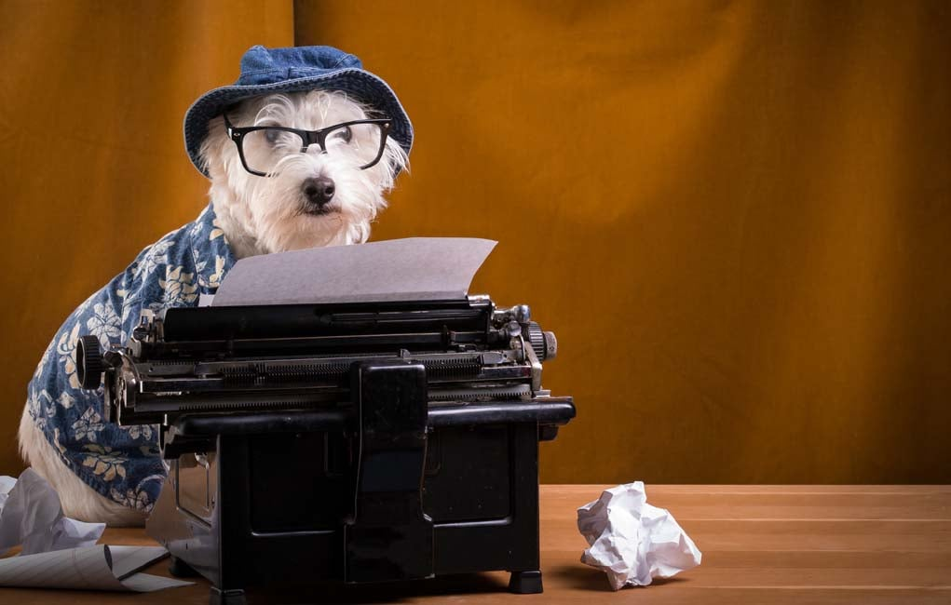

Define a Function
function candyPop() {
alert("I want candy");
}
function
Function Name
Parentheses: ( )
Curly Brackets: { }
Body in brackets

Slide 10
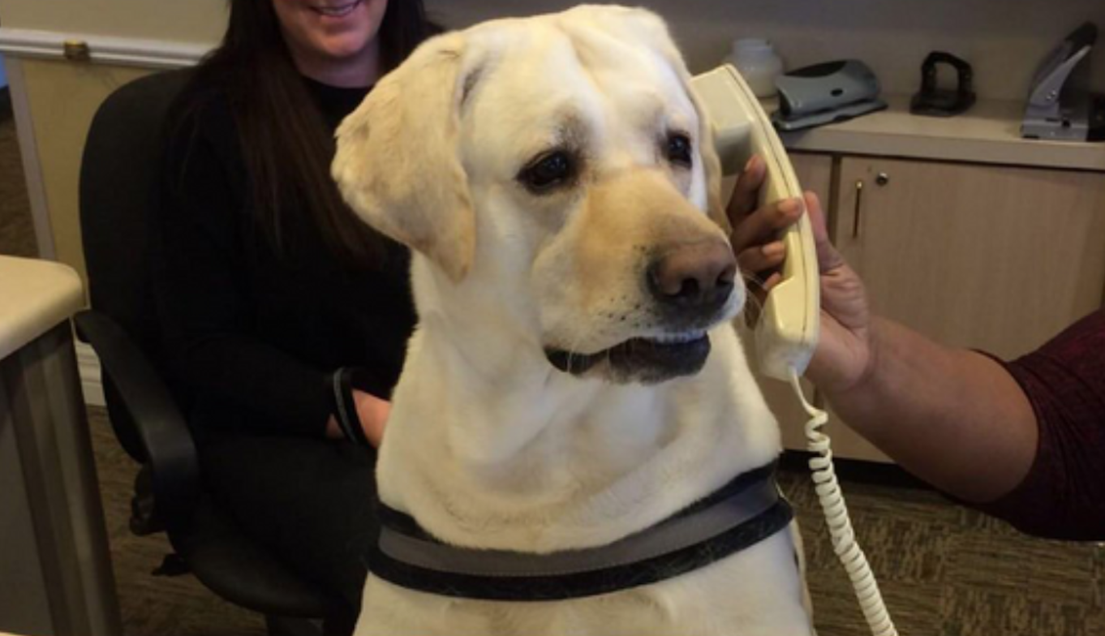
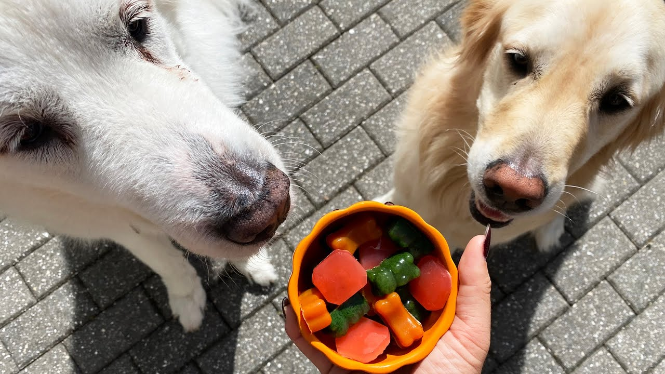
Call a Function
Function Name
Parentheses: ( )
candyPop()

Slide 11
The End
Questions?

